Slide 1
When the Lights go out
---Implications of Being Computer Dependent and Lessons Learned

Slide 2
Learning Objectives
Identify vulnerabilities, outsourcing, and backup capabilities
Define a downtime Policy
Build resources and preparations for an electronic record disaster
Explore a partnership to support critical functions and share lessons learned

Slide 3
The Code Black- a true story
July 14th 2018, almost 2 years after EMR go live, we lost our whole IT system.
  Computer
    Virtual Servers (2) went down
    Cerner was still up in Kansas City, no internet connection to it.
    450 unique apps in our servers.
  Ancillary: i.e.: Lab/ Xray
    Outside lab service also went down for that weekend.
  ED didn’t close or divert
  eICU= remote night time ICU service went dark.
  Voice over IP phones
    Authorizations
    Scheduling
  Printer Label dependence such as Blood bank
  CALL BELLS!
  Patient tracking
  Chaos????
  Welcome to EHR appreciation week!

Slide 4
The preparation we had:
83 “Black Boxes” on the patient care floors
  Inpatient Nursing focused– floors, peri-op, ED
  Contained:
    “Grab Me First” Binder
      Table of Contents
      Downtime policy
      Instructions
      Red phone numbers
      Forms for after the initial chart set up
    24 hours of set up
      There was a “first round” chart set up then after that charts had to be rebuilt.
      A nurse could grab her room charts and start charting

Slide 5
How we dealt with it
Patients:
  Transparency: they were our #1 priority
    Uncertainty and lack of communication did hamper this
  Did not consistently track patient locations
  Families and providers could not call in
  Patient could not call for scheduling
Staff
  Believe it or not, there were many nurses that had never paper charted in their life
    Nor were they ever taught in Nursing school
  Nursing Admin looked after nursing documentation
  Case Management and Utilization Review kept pushing forward
Providers
  Creative
  Frustrated
  Overwhelmed
  UGGH!

Slide 6
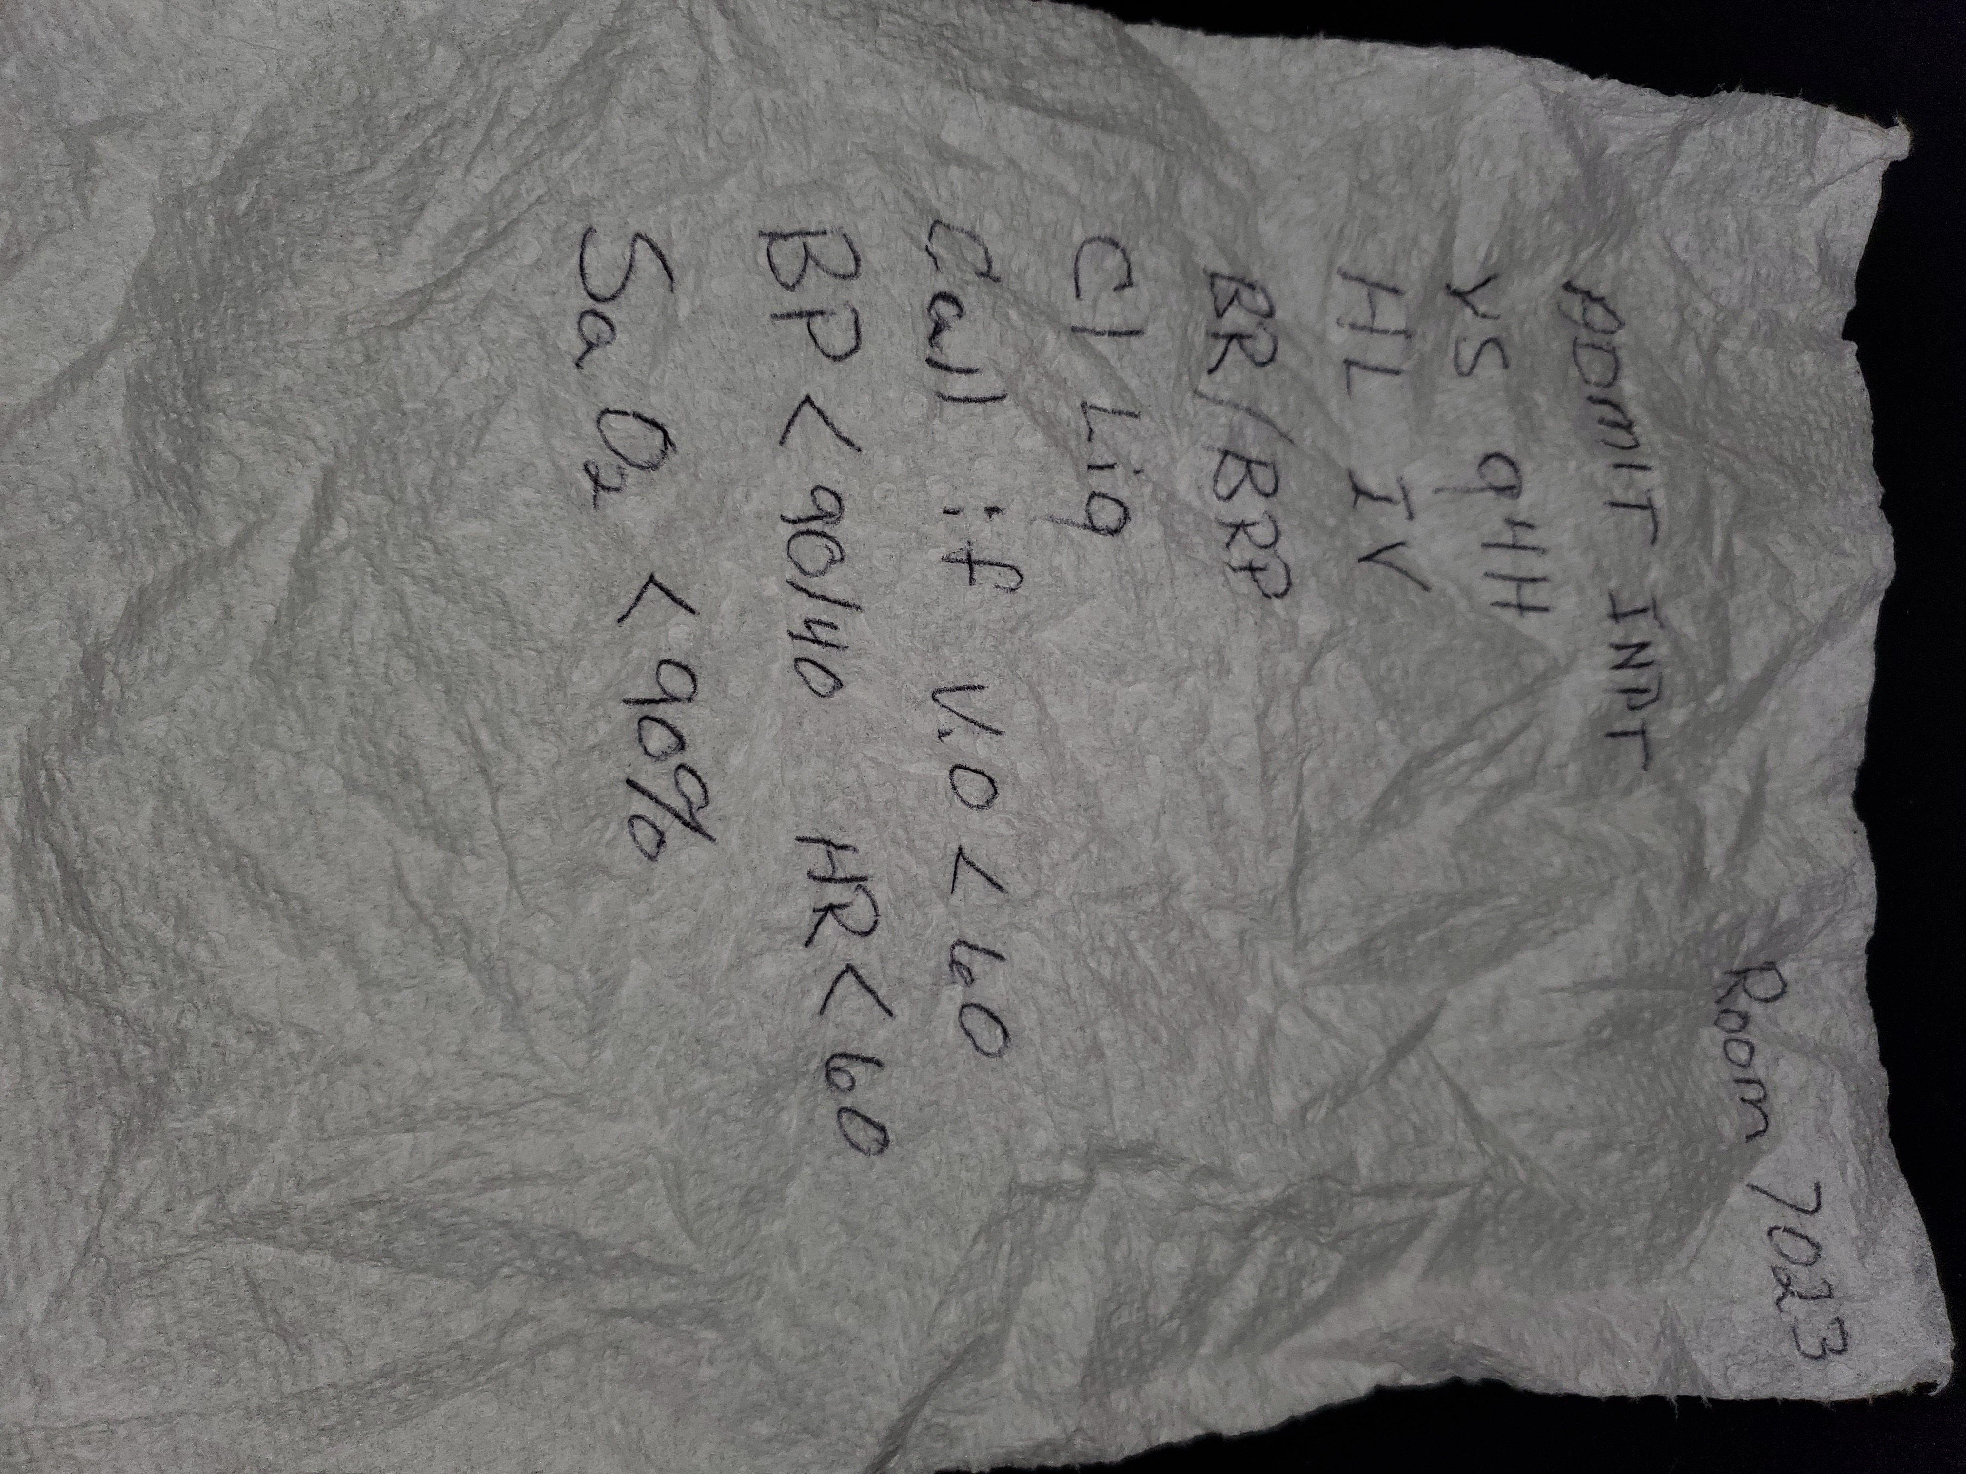
Findings

Slide 7
CDI, WHO?????
How long is this going to last?
To query or not to query
Vacay Baby!
  Started with 2 days off because of no work
  Uncertainty of when we would get back on line
How can we best help all parties?
Final Blow: TJC visit 2 weeks afterwards!

Slide 8
CDI to the Rescue
No Remote CDI out of necessity
  Charts were on the floors
  Shifted staff
  Even had someone go to an outlying hospital
Looked at Census daily to allocate staff
Had CDI track as best as they could their findings
No Querying
  Would have been too taxing on the providers
Looked at all physician documentation in the paper records
Assure that status orders were in place
Looked for H&P and Op Report presence

Slide 9
CDI Reviews
Every incomplete order was flagged
  With an EMR, signing dating and timing is done automatically.
H&P/ Op Reports
  We have a dictation service that did not go down.
  Had to check and have those documents “pushed” to the charts when we were back up
  Otherwise we would leave a post-it note on the front of the chart
Beyond that there was nothing more we could do
Providers forgot about the paper chart as soon as the EMH was online.

Slide 10
Our Work
In 2 days:
Reviewed over 300 charts= 37.5 charts per CDI
Flagged about 600 noncompliant orders
Our CDI software took a few days longer to come back on line
  We were not mission critical
  Had to follow paper charts of the pts still in house after the EMR went back online.

Slide 11
Note to Administration
Last week CDI altered our workflows
  Reviewed the paper charts to flag non-compliant orders
  Ensured there were status orders on the charts
  Reviewed over 300 charts and flagged in excess of 575 orders in 2 days
Friday, Monday and Tuesday, CDI reviewed charts as usual
Starting Wednesday, we have been doing our best to get the hard copy provider documentation ready for TJC
  There are still approximately 100 paper charts on the floors
  Ongoing review of orders and noting deficiencies for providers
  Ongoing reviews for missing H&P’s and Op reports
  Posting a list of providers with paper record deficiencies in the physician lounges and notifying specific practices.

Slide 12
Fallout
DNFB: before 4.0
After 17.13 max.
Lasted 3 weeks
  Medical Records wanted to take 8 weeks
Returned to mostly normal after 5 weeks.
Measured 22 FEET of paper for scanning.
Very Important!
  Reporting metrics will be lost, if not off
    July will be low, August will be high
  Providers forget about the paper charts the very day the EMR came back online
    Could not find the documents in the EMR (the papers were still on the floor)

Slide 13
Lesson Learned: Handwriting
When converting to downtime : hand writing takes a lot longer and not as efficient
hand writing deteriorates after many hours of writing
We are not as proficient at reading provider handwriting as we used to be.
Many MAR experiences, so MAR documentation was not standardized.

Slide 14
Lessons learned- Vulnerability
Our #1 vulnerability is Internet Connection
  Car wreck or Back hoe to fiberoptics…
  MalWare!
What outsourcing capabilities do you have? Notifications?
What ancillary support do you need for the OR?
  Pathology
  blood bank
For procedures/ studies, what storage capabilities is there for the instrumentation?
  Radiology: had limited storage space
Radiologists need to have diagnostic quality films, light boxes not enough anymore and not big enough if they are still around.
Emergency backup systems are really for critical studies not full day’s workload.

Slide 15
lessons learned- Health Information
Forms committee needs to manage
  Gaps in Document inventory.
  Documents need to be reviewed periodically
  Possibility of standardized forms for downtime
Chart preparation (called stuffing the chart) for the next day
Cover shred bins with a DO NOT SHRED sign
  Only remove after Medical Records approves
Disorganized locations of documents in the charts
Papers found in random locations
Timing: critical time changes
  Midnights
  Shift changes

Slide 16
lessons learned- Coding
There will be no work---period
  Manager was relentless in hounding Medical Records for work
  Offered non clerical services
  Coders had about two weeks without Charts
When the charts started flowing
  700 in the coding queues
  Coders were very discouraged
  List didn’t drop in size
  Manager implemented minimal overtime
    8 hours the first week to all coders (13 coders)
    4 hours the second week

Slide 17
Lessons Learned for CDI
Have a downtime protocol with needed forms
  2 different kinds:
    Total EMR blackout
      Documentation support
        Be careful of CDI dependence
        Need an end time for assigned tasks
        Don’t let everything fall on the Documentation specialists
      We supported the physicians
      Work with Medical Records for a physician “black box”
    CDI Software
      Hard copies of query templates
      Consider when to backfill and how much time this will take.
  Be Flexible and patient
  We did not take patient assignments

Slide 18
Lessons learned: For the Future
Practice yearly competencies
Drill
Coordination of information

Slide 19
Final Thoughts
Look to neighboring Health systems for possibility of support.
  Such a pathology services.
  Share downtime protocols
  Reciprocate!
Nothing is too simple
  Get a supply of PENS!!!!!

