Slide 1
Building a Successful Mentorship: Tips for the Mentor and Mentee
Karen Bridgeman, MSN,RN, CCDS Claudine Hutchinson, BSN, RN
CDI Educator CDI Specialist
Medical University of South Carolina The Children’s Hospital at Saint Francis
Charleston, SC Tulsa, OK

Slide 2
Learning Objectives
At the completion of this educational activity, the learner will be able to:
  Discuss the importance of a mentorship.
  Describe the benefits of a mentorship for both the mentor and the mentee.
  Describe strategies for establishing a mentorship from both the mentor and mentee perspective.
  Identify characteristics needed for developing a mentor role.

Slide 3
Polling Question
I would like to be a mentor.
I am looking for a mentor.
I want to learn more about mentorship.
I want to develop a mentorship program for my CDI department.
Other

Slide 4
Medical University of South Carolina Children's Hospital
Medical University of South Carolina
Children’s Hospital
Major academic and tertiary patient referral center for all of South Carolina
Three hospitals
  University
  Institute of Psychiatry
  Children’s
709 beds
Level 1 trauma center
186 licensed beds
Service lines
  Pediatric ICU
  Pediatric Cardiology
  Pediatric Hospitalists
  Pediatric Heme-Oncology
  Pediatric Pulmonary
  Pediatric Neurology
  Pediatric Emergency Dept.
  Neonatal Services
    Level III Nursery

Slide 5
Medical University of South Carolina CDI Department
Began in 2005 for adult services
  Expanded in 2007
    Additional staff and reviews
  Currently 15 CDI Nurses
Pediatric CDI began January 2012
  Two CDI nurses dedicated to pediatrics (2 FTE)
  Concurrent reviews for all payors
    Discharged with open queries
    Coder – CDI discrepancies
    Death reviews

Slide 6
Medical University of South Carolina CDI Department
Began in 2005 for adult services
  Expanded in 2007
    Additional staff and reviews
  Currently 15 CDI Nurses
Pediatric CDI began January 2012
  Two CDI nurses dedicated to pediatrics (2 FTE)
  Concurrent reviews for all payors
    Discharged with open queries
    Coder – CDI discrepancies
    Death reviews

Slide 7

What is a Mentorship?
Created with www.wordle.net

Slide 8
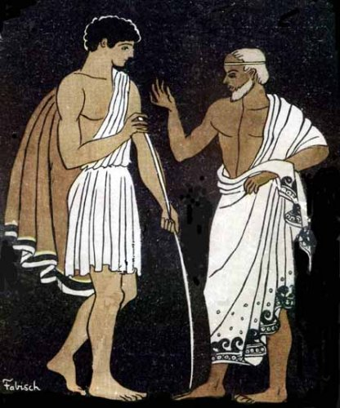
What is a Mentor?
“Mentors in the workplace are simply people who help other people succeed.”
Neave Hospital South Minnesota
https://commons.wikimedia.org/wiki/File%3ATelemachus_and_Mentor1.JPG

Slide 9

What is a Mentee?
“A person who is
advised, trained, or
counselled by a
mentor.”
English Oxford Living Dictionary
Stock vector ID: 519803680

Slide 10
Mentorship vs Orientation
Mentorship
Orientation
Long term
Relationship oriented
Purpose
  Encourage
  Guidance
Development driven
Does not evaluate performance
Trust and confidential
Development opportunities for both mentee and the mentor
Short term
Task oriented
Purpose
  Teach specific job skill set
  Introduce policies & procedures
Performance driven
Competency evaluated
Well defined outcomes
Growth for the orientee

Slide 11
Why Mentorship is Important
Effective with problem solving and dealing with others
  Physicians
  Coders
Assists in predicting career success
  Improved performance
  More salary increases and promotions
  Higher job satisfaction
  Increased loyalty and decrease turnover
  May provide social support that reduces employee stress
    Reduce frustration
    Empowers to problem solve

Slide 12
Seven Attributes for Mentors
Mentor
Expertise
Communication Skills
Role Model
Commitment
Positive Attitude
Time Management
Caring

Slide 13
Informal Mentorship
No management engagement
Loose goals
Unknown outcomes
Self selection of mentors and mentees
May be lack of expertise
Lack of formal management support
Lack of accountability
May be long lasting
Indirect organizational benefits

Slide 14
Formal Mentorship
Consult management
Establish goals
Measurable outcomes
Participation voluntarily
Matching of mentee with mentor
Identify time commitment
Identity energy in developing relationship
Accountability of mentor and mentee
Dedicated time to meet
Organized agenda

Slide 15
Mentorship Off-Site
Beneficial for small community hospitals with limited CDI specialists
Conveys that management is willing to invest in their employees
Experience can be customized to address the needs of the CDI mentee
Decreased distractions helps mentees absorb more information
Networking with experienced CDI specialists
Eliminate costly consultant fees

Slide 16
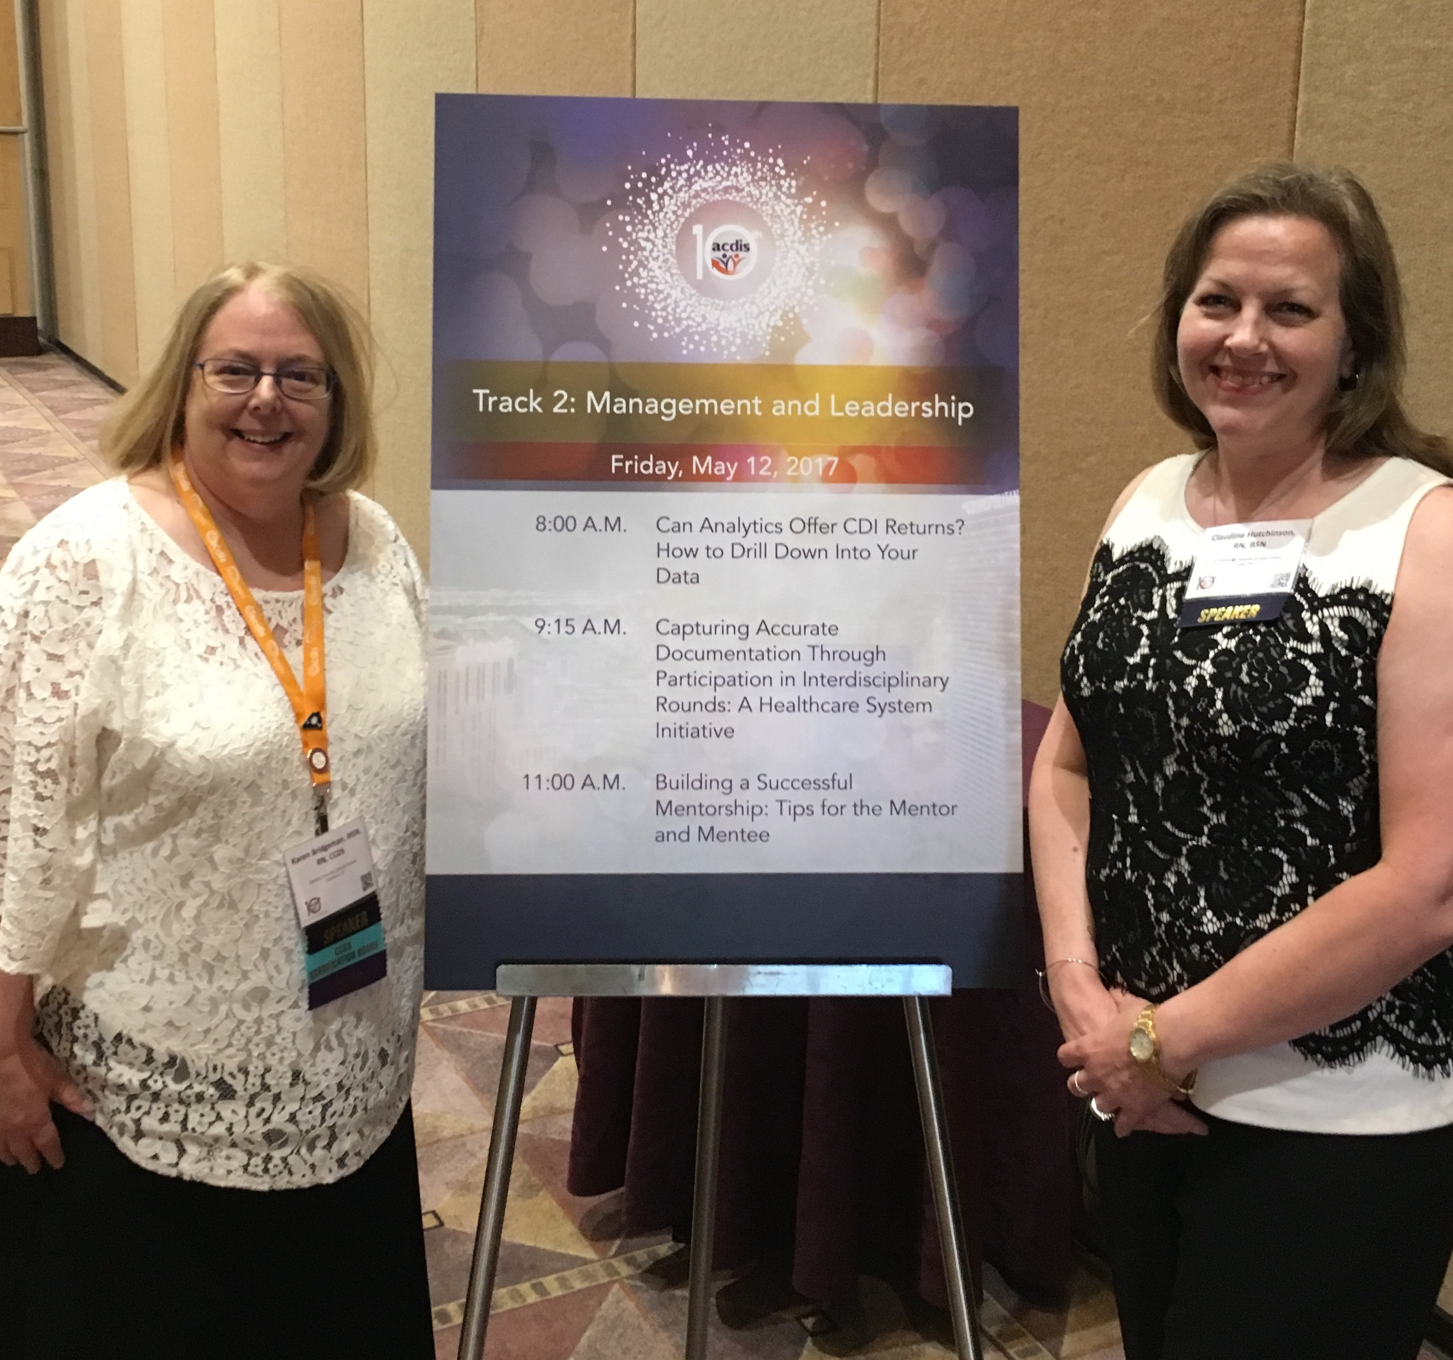
Meet Claudine

Slide 17
Saint Francis Health Care System
The Children’s Hospital
at Saint Francis
Saint Francis Health System
Nonprofit, Catholic organization
Six facilities
  Saint Francis Hospital
  Children’s Hospital at Saint Francis
  Laureate Psychiatric Clinic and Hospital
  Warren Clinic
  Saint Francis Hospital at Broken Arrow
  Saint Francis Heart Hospital
1113 beds
Level 2 Trauma Center
162 licensed beds
Service lines
  Pediatric Cardiology/Cardiac Surgery
  Pediatric Heme-Oncology
  Pediatric Pulmonary
  Pediatric Neurology
  Pediatric Emergency Dept.
  Pediatric Hospitalists
  Pediatric ICU
  Neonatal Services
    Level IV NICU
St. Jude Affiliate Clinic
  Pediatric hematology / oncology

Slide 18
The Children’s Hospital at Saint Francis CDI Program
Pilot program October 2010 – June 2011
Permanent position in July 2011 (1 FTE)
  Medicaid reviews
    Concurrent reviews
    Discharges with open queries
  Resident CDI education monthly
  Coder-CDI DRG Mismatch
  Coding – Physician Liaison
    Contact physicians for outstanding coding queries
  Denial reviews and Appeal Letters

Slide 19
Claudine’s Story
Initial CDI training
  Adult CDI program at affiliated hospital
    Lack of application of pediatric knowledge
    Limited orientation
  Outside Consultant training
    Pediatric focus for CDI
    Classroom oriented
Limited support
  Lack of physician engagement
  No pediatric physician advisor
  Sole CDI specialist
Limited resources
  Manual spreadsheets
  Manual worklist for daily census
  Manually determined the MS-DRG grouper
  No CDI software or encoder
  Single monitor
  Lack of pediatric resources
Increasing frustration with decreasing job satisfaction
  Long hours
  Managing workload tedious

Slide 20
Claudine Begins
You don’t have to be great to start, but you have to start to be great.
Zig Ziglar
2012
  Pilot Pediatric CDI program became official
  Emailed several ACDIS’s pediatric subgroup (APDIS) seeking assistance on pediatric CDI programs
2013
  separated from adult CDI program
  The adult program’s CDI software is available only as a reference to the Pediatric CDI program
2014
  CDI Strategies “CDIS Exchange Day”
    Discussed with manager who approved of shadowing opportunity
  Emails and posted on ACDIS CDI Talk requesting someone willing to mentor
    Responses with offers to assist but not able mentor
    Response with opportunity for mentorship
  Administration constraints with program feasibility with return on investment hindering implementing mentoring opportunity
  Continued reaching out for support via e-mails and CDI Talk (ACDIS Forums)
2015
  Attended the 8th ACDIS National Conference in San Antonio with four pediatric breakout sessions
  Opportunity to network with future mentor
2016
  Administration gave approval for on-site mentorship

Slide 21
Seven Attributes for Mentees
Mentee
Listening Skills
Positive Attitude
Motivation
Eagerness to Learn
Respect
Communication Skills
Time Management

Slide 22
Mentee Planning
Discuss with management
  Expenditures
  Time commitment
  Productivity
  Expectations and goals
Consult with hospital compliance and legal departments for required approval
Develop a time frame for a site visit
Identify goals for the experience
Discuss expectations of the experience
  Dress code

Slide 23
Mentor Planning
Discuss with management
  Expenditures
  Time commitment
  Productivity
Consult with hospital compliance and legal departments for required approval
Develop a time frame for a site visit
Discuss expectations of the experience
Identify goals for the experience
Develop an agenda
  Time to meet with physician advisor
  Include rounding with physician and team
Recommendation for hotels, transportation, dining
Create notebook with copies of checklists, training materials, resources, and other tools to be used during visit

Slide 24
Develop an Agenda
Agendas are an effective tool to ensure a productive and successful mentorship
Develop with the mentee to ensure their needs are met
Identifies issues to be discussed
Sets goals and identifies outcomes to be achieved
Keeps the mentorship focused
Provides a written reminder of what needs to be accomplished
Provides documentation of expected goals and outcome for management approval

Slide 25
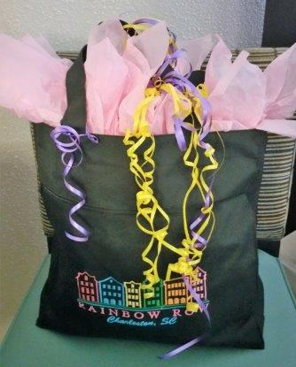
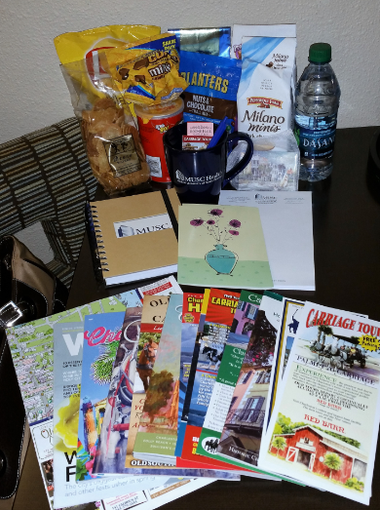
Prepare For The Mentee Arrival
Welcome Basket
  Snacks for hotel room
  Water
  Token gift with host logo
  Hospital Map
  Host city tourist information
    Map
    Things to do in evenings
First day meet and greet your CDI team
Tour hospital with introduction to units and staff
Have an office space set up for mentee
Welcome Basket [Personal photographs taken in Charleston, SC]. (2016, April).

Slide 26
Mentorship Calendar
Time | Monday | Tuesday | Wednesday | Thursday | Friday
8:00
 |  |  |  |  | Dr Danielle Scheurer Chief Quality Officer
9:00 | Welcome Breakfast |  | Pediatric Hem-Onc Rounds |  | Sylvia Odom CDI Manager
 |  | General Peds Rounds w/Dr Teufel
10:00 |  |  |  | Develop New Resident Presentation | Pediatric Metrics
 | Pediatric Surg Rounds |  | Dr Mark Scheurer (office)
11:00
12:00 | Review Workflow - EPIC Processes | YES Campaign Luncheon | Dr Scott Russell (office) | Dr David Habib (PICU)
 |  |  | Dr John Cahill (office)
1:00 | Leapfrog to Ped CDI | Review Pediatric CDI Presentations
2:00 |  |  | Charlene Ardis (office) | Develop Sepsis Presentation
3:00 | Dr Mills RT 280R
4:00
5:00

Slide 27
Mentorship in Action
Met with members of the Pediatric CDI Committee
  Discuss their role in the Pediatric CDI Committee
  What got you to engage in the Pediatric CDI Committee
  Share any tips that might be helpful to engage other physicians
Rounding with hospitalist team
  Demonstrated effective communication strategies
Review workflow processes
  Demonstrated effective and efficient use of CDI software
  Reviewed electronic health record processes
  Reviewed concurrent, retrospective, open queries, coder-CDI mismatch, and mortality review processes
Reviewed Pediatric CDI Committee presentations
  Developed effective physician education

Slide 28
Claudine’s Take Away
Tips for engaging physicians
  Teach the physicians the buzz words needed for coding
  Show the impact of documentation to the physicians
    Severity of illness and Risk of mortality
    Increased physician quality scores
    Decreased reimbursement due to insufficient documentation vs. increased revenue with accurate documentation
    Increased revenue generates needed resources for the physicians for improved patient care
    Benefit of chocolate chip cookies
  Physician advisor needs to be well respected by peers, approachable, participative and committed to improve clinical documentation

Slide 29
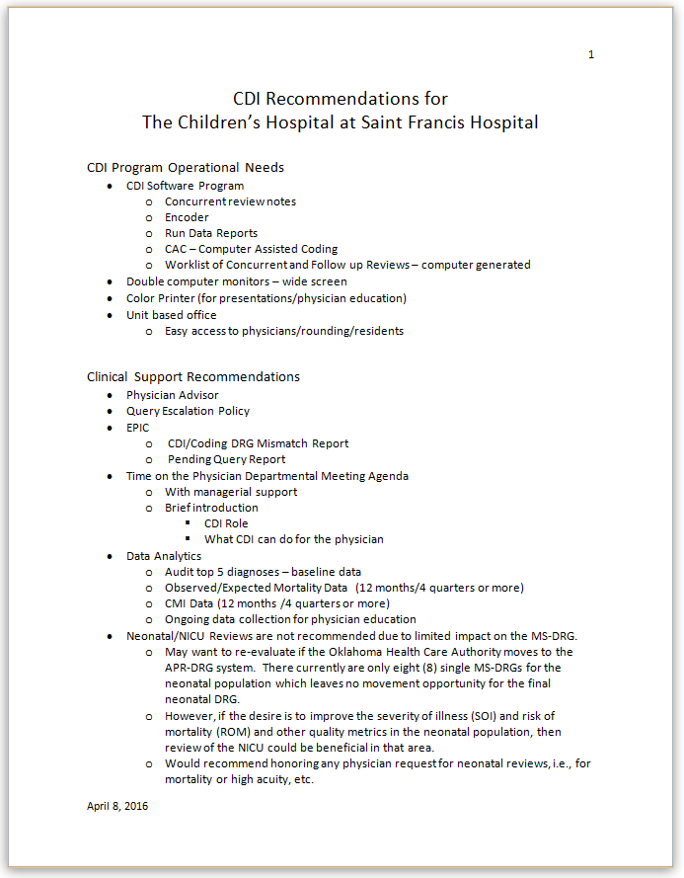
Recommendations
Management may not support all recommendations
Recommendations may be implemented slowly
Start small with biggest impact
Dual Monitor
Requested time on pediatric physician meeting agenda

Slide 30
Claudine’s Success
Increased physician engagement
  Physician Advisor – volunteer
  Query response rate
    Increased from 70% to 91%
EHR improvements
  Daily Medicaid census in EHR
  Development of EHR coder-CDI mismatch report
Decreased frustration with increased job satisfaction
Additional FTE in 2017 for 2nd CDI specialist
  CDI software to be purchased
Children’s Hospital CDI Committee - Pending
  Executive Director of The Children’s Hospital at Saint Francis
  CDI Specialist
  Pediatric Hospitalists
  Pediatric Case Managers

Slide 31
What Worked and What Didn’t Work
What Worked
What Didn’t Work
Return emails promptly
Assist mentee with finding resources
Demonstrate processes
Meeting with physicians
Mentor recording notes during physician meetings
Rounding with physicians
Ask thought provoking questions
Flexibility
Ensure that all needed paperwork is completed prior to arrival
Hotel arrangements near restaurants and entertainment
Inability to fully explore every item on agenda due to time constraints

Slide 32
Mentor: Keeping the Mentorship Flourishing
Mentoring is a long term supportive learning relationship
Develop the relationship by getting to know each other
Reach out and follow up on progress in timely sequences
Continue to share knowledge and ask questions
Actively participate and keep communications open
Define your expectations and limitations
Be honest and respect each other
Be reliable and consistent in maintaining support
Stay positive

Slide 33
Mentee – Keeping the Mentorship Flourishing
Identify your greatest areas of need and opportunities
Nurture your relationship
Be prepared
Actively participate
Maintain communication
Be respectful of each other’s time and commitments
Be willing to reach out
Take ownership of the mentorship
Offer support
Be innovative and creative
Be reliable and consistent
Stay positive
Share your outcomes often
Send a handwritten thank you note
PAY YOUR MENTORSHIP FORWARD!

Slide 34
Let’s Look At Our Polling Question Again
I would like to be a mentor.
I am looking for a mentor.
I want to learn more about mentorship.
I want to develop a mentorship program for my CDI department.
Other

Slide 35
Claudine’s Post
chutchinson
September 2014 edited May 2016 in CDI Talk Archive
Hello.
In today's CDI Strategies regarding activities for CDI week, it
mentioned doing a CDI specialist exchange day where one shadows a CDI
specialist at another facility. Anyone interested in exchanging
information (via email/phone) about their CDI program, computer program
(especially if use Epic), and possibly shadowing at another facility
(local, state or nationally)? If so, please reply or contact me. Thanks!
:-)
Claudine Hutchinson RN
Clinical Documentation Improvement Specialist
Children's Hospital at Saint Francis
Email: chutchinson@saintfrancis.com

Slide 36




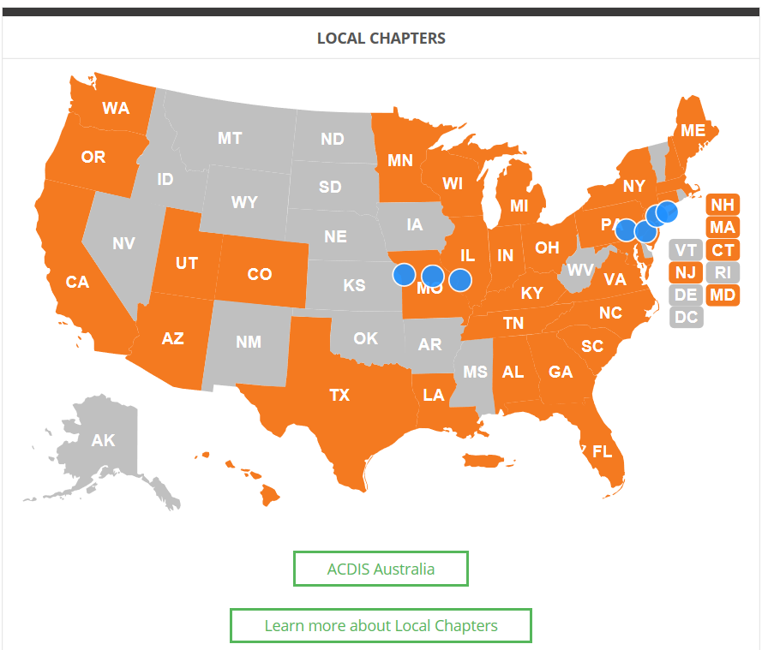
How To Find a Mentor
ACDIS
  State ACDIS Chapters
  Annual Conference
  ACDIS Forums
Request contact information
Email
Ask questions
Job shadowing
LinkedIn

Slide 37
Thank you. Questions?
Karen Bridgeman bridgema@musc.edu
Claudine Hutchinson chutchinson@saintfrancis.com
In order to receive your continuing education certificate(s) for this program, you must complete the online evaluation. The link can be found in the continuing education section at the front of the program guide.

